Slide 1
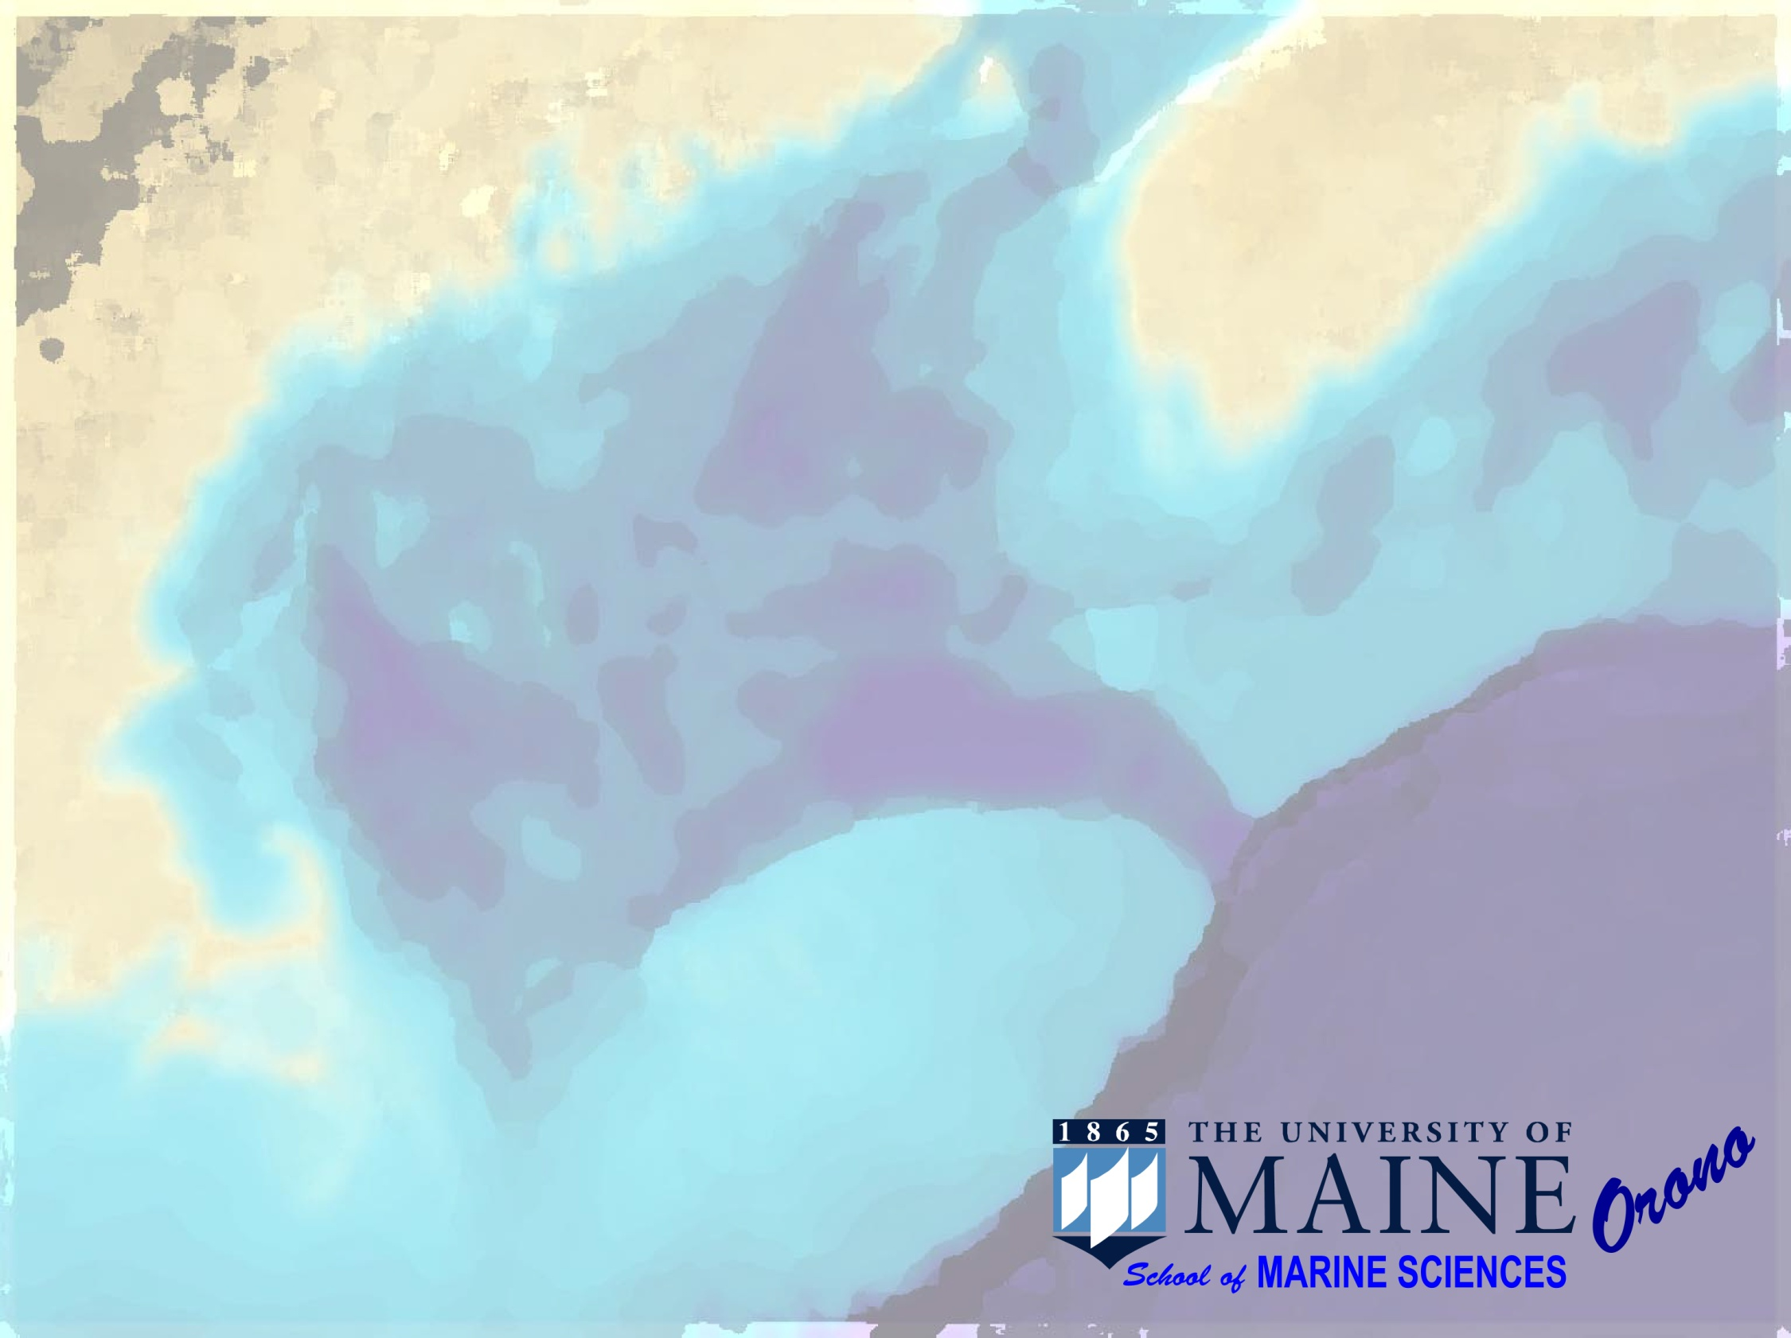
A Nutrient Climatology for the
Gulf of Maine − Georges Bank Region
June 23, 2008
David Townsend
Nathan Rebuck
Maura Thomas

Slide 2
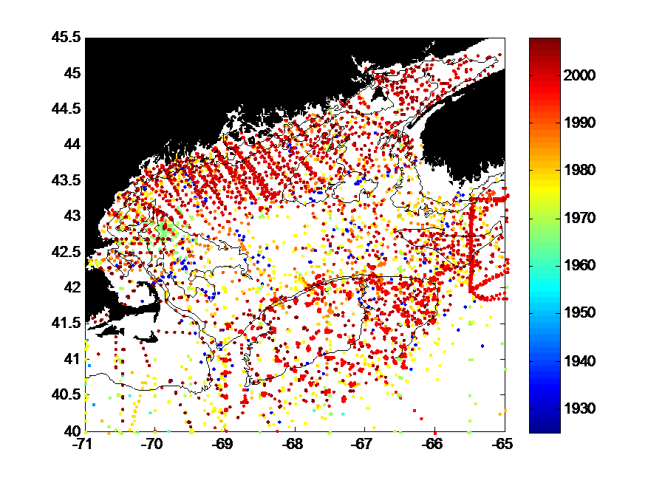
Year
N>73,889

Slide 3
GoM Nutrient Database (as of 1 Apr 2008):
Rebuck/Townsend, University of Maine
Data Sources
WOD- (1930-2006; incl. Dec 2007 update )
http://www.nodc.noaa.gov/OC5/WOD05/pr_wod05.html
DWT– (1998-2007)
DWT-GLOBEC– (1997-1999)
DWT-GOMTOX – (2007)
WHOI- (2003-2006) provided by D. McGillicuddy
PETRIE- (1925-2005) provided by B. Petrie (BIO).
  Marine Environmental Science Division (MESD) at BIO as well as the Marine Environ Data Serv. (MEDS) in Ottawa.
AZMP-(1999-2006) Atlantic Zone Monitoring Program AZMP
  Integrated Science Data Management (ISDM), as part of the Dep. Fisheries and Oceans Canada (DFO)
UNH-COOA-(2004-2008) http://www.cooa.unh.edu

Slide 4
Rebuck/Townsend GoM Regional Nutrient Data Sources |  | Year Sampled |  | Number of Samples
WOD |  | (1930-2006) |  | 49,551
PETRIE |  | (1925-2005) |  | 29,064
DWT (Misc) |  | (1998-2007) |  | 12,639
DWT (GLOBEC) |  | (1997-1999) |  | 3,925
DWT (GOMTOX) |  | (2007) Two cruises! |  | 3,249
WHOI |  | (2003-2006) |  | 6,478
AZMP (DFO Canada) |  | (1999-2006) |  | 1,893
Univ. NH (COOA) |  | (2004-2008) |  | 1,481
TOTAL |  | (1925-2008) |  | 108,232
~73,000 within gridded domain

Slide 5
Total Samples
# of samples
Year (binned annually)
Year (binned annually)
Samples Analyzed
only since 1960
# of samples

Slide 6
Seasonal Distribution of Sample Collections:
Number of samples
month

Slide 7
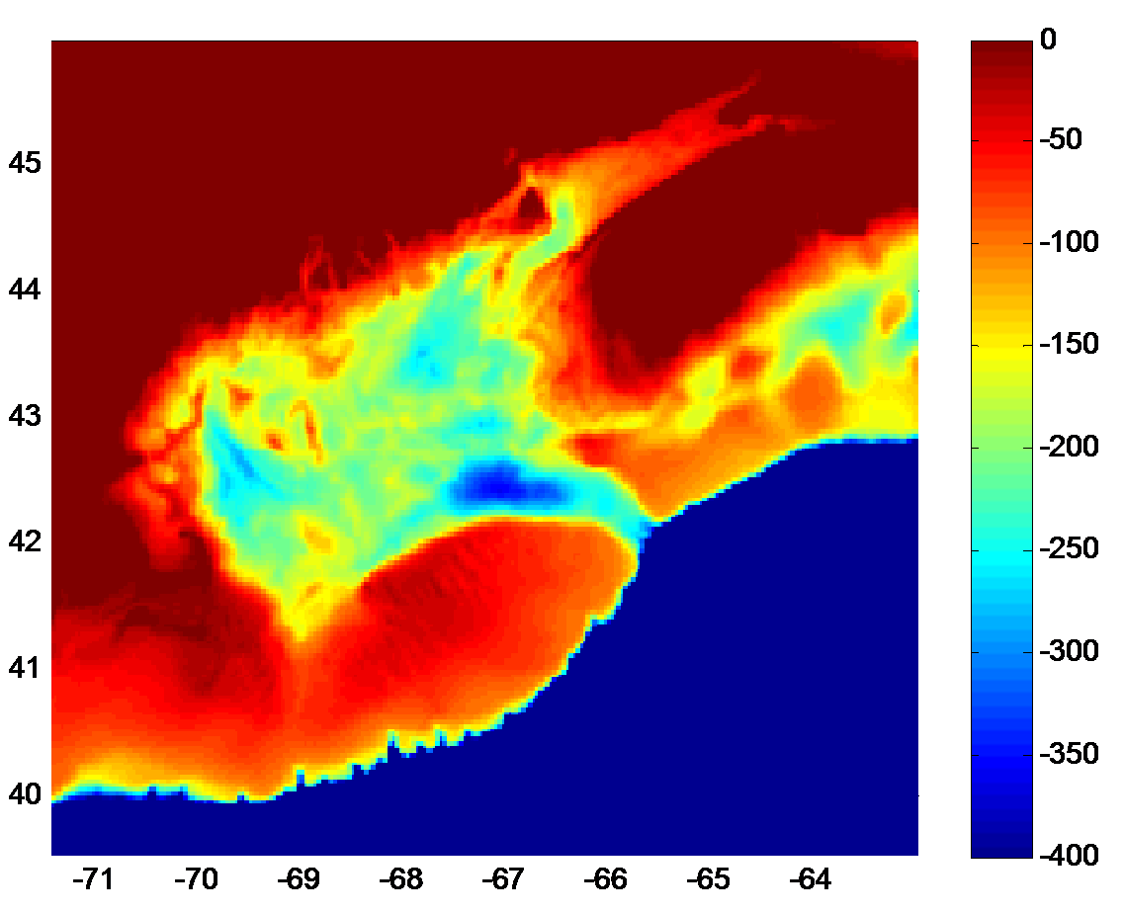
Grid Size = 2x2 minutes

Slide 8
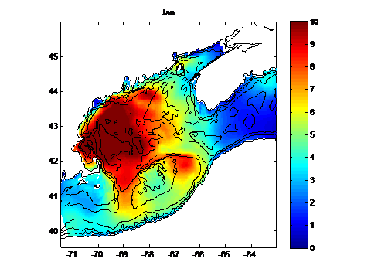
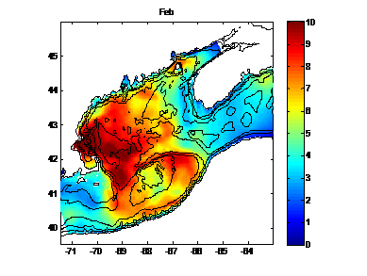
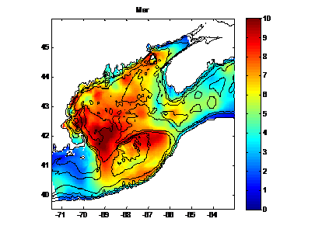
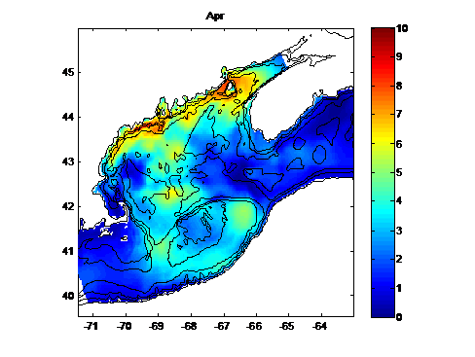
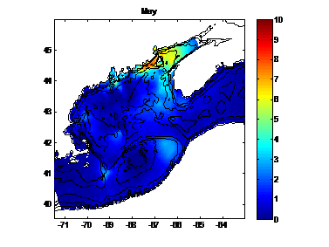

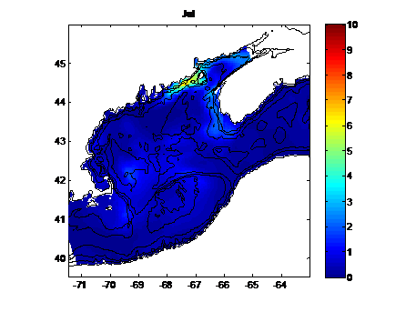


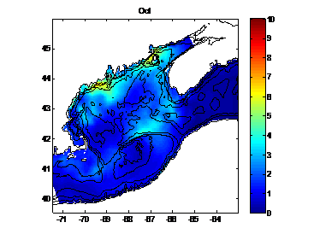
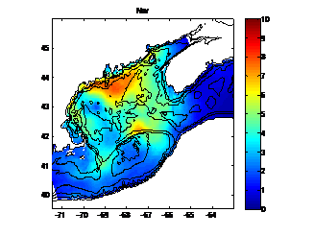
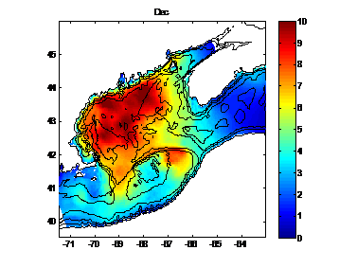
Gridded monthly products – Surface Nitrate
Jan
Feb
Mar
Apr
May
Jun
Jul
Aug
Sep
Oct
Nov
Dec

Slide 9
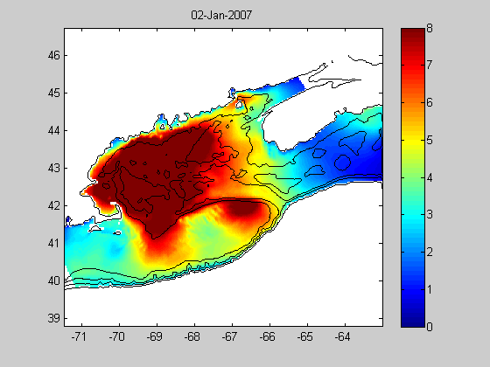
Annual Cycle: Surface NO₃

Slide 10
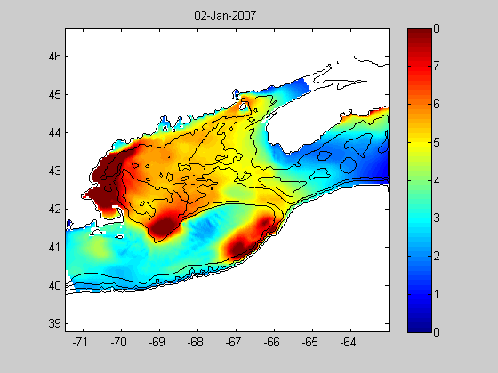
Surface Silicate
N=48,346; much lower confidence in offshore winter months

Slide 11
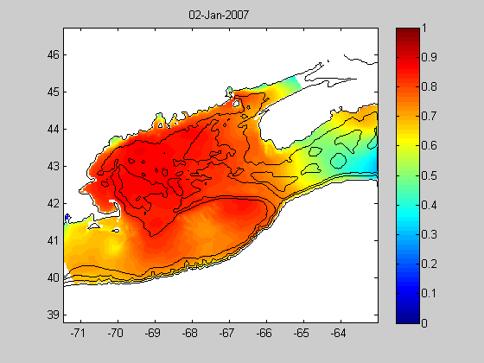
Potential Primary Production (NO₃-based):
e.g., Prod α
V/Vmax = NO₃/(NO₃ + Ksp)… Ksp=1.5uM

Slide 12
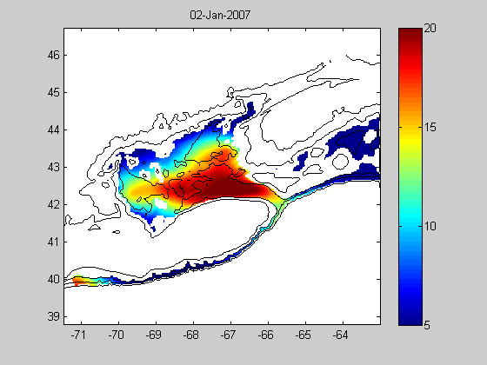
200m NO₃ (with 150m mask)
  Note cool colors inshore are generally shallower than 200m (i.e. junk data from gridding), but larger coherent trends in basins are data-driven

Slide 13
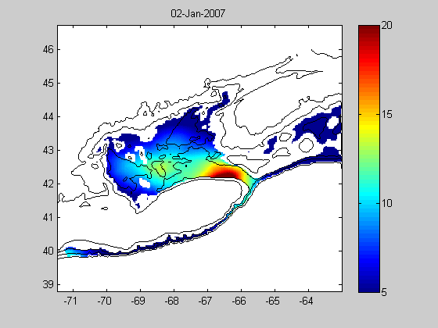
200m Si(OH)₄ (with 150m mask)
  Note cool colors inshore are generally shallower than 200m (i.e. junk data from gridding), but larger coherent trends in basins are data-driven

Slide 14
Methods
~2 minute grid, smoothed version of the USGS 15 second bathymetric grid (from K. Smith, WHOI)
Objective analysis for 12 months (calculated for the 15th of each month)
nine z-layers (1m-10m-20m-30m-40m-50m-100m-150m-200m)
calculated as z ±5 (0-5, 5-15, 15-25, 25-35, 35-45, 45-55, 95-105, 145-155, 195-205)
Computed based on relative weightings of x, y, z, date, Temperature, Salinity, and log(bathymetry) to retain some separation across frontal zones and along the shallower contours
Gaussian weighting function for all parameters; standard deviations for each x,y=50km,
z=10m,
date=30 days
Temperature=2.5°C,
Salinity=.5 psu,
Log bathymetry=.5,

Slide 15
Notes:
From the monthly calculations (centered on the 15th of each month), linear interpolation between months to generate the smooth animation
after March 15, influence of April 15th begins rapid drawdown that proceeds through May
Features to watch:
- coastal region, both Nova Scotia, Eastern Maine, and Western Gulf
- Browns Bank “feeding” the NS side of the Coastal Current
- GSC and NE Peak of Georges with higher values in early summer
- highest values in western gulf in late winter/early spring
- low values south of Cape Cod into Mid-Atlantic region

